Slide 1
Welcome to CSC 455 Machine Learning
Salem State University
machine learning Fall 2022
Dr.Fatema Nafa

Slide 2

CSC 455: Machine Learning Lecture #1 Introduction

Slide 3
Outlines
Why machine learning?
Problems that machine learning can solve
Knowing your data
Why Python?
Scikit-learn
Installing Scikit-learn
Essential Libraries and Tools
Python2 versus Python3
A First Application: Classifying iris species
Meet the data
Measuring Success: Training and testing data
First things first: Look at your data
Building your first model: k nearest neighbors
Making predictions
Evaluating the model

Slide 4
Learning Objectives
Identify data-driven learning vs. expert or domain knowledge-based approaches
Provide examples of machine learning used today
Given a new problem, qualitatively describe how machine learning can be used
Formulate a potential machine learning task
Identify the data needed for the task
Identify objectives
Classify a machine learning task:
Supervised vs. unsupervised, regression vs. classification
For supervised learning, identify the predictors and target variables

Slide 5
Outline
What is Machine Learning?
Types of machine learning algorithms
Classification
Regression
Unsupervised learning
Why the hype today?
Some slides from:
A. Zisserman, “Machine Learning Introduction”
Alpaydin, “Introduction to Machine Learning”

Slide 6
Machine learning is about extracting knowledge from data. It is a research field at the intersection of statistics, artificial intelligence and computer science, which is also known as predictive analytics or statistical learning. The application of machine learning methods has in recent years become ubiquitous in everyday life.
From automatic recommendations of which movies to watch, to what food to order or which
products to buy, to personalized online radio and recognizing your friends in your photos, many modern websites and devices have machine learning algorithms at their
core.
When you look at at complex websites like Facebook, Amazon or Netflix, it is very likely that every part of the website you are looking at contains multiple machine learning models.
Outside of commercial applications, machine learning has had a tremendous influence on the way data driven research is done today. The tools introduced in this book have been applied to diverse scientific questions such as understanding stars, finding distant planets, analyzing DNA sequences, and providing personalized cancer treatments.
Your application doesn’t need to be as large-scale or world-changing as these examples in order to benefit from machine learning. In this chapter, we will explain why machine learning became so popular, and dicuss what kind of problem can be solved using machine learning. Then, we will show you how to build your first machine learning model, introducing important concepts on the way.

Slide 7
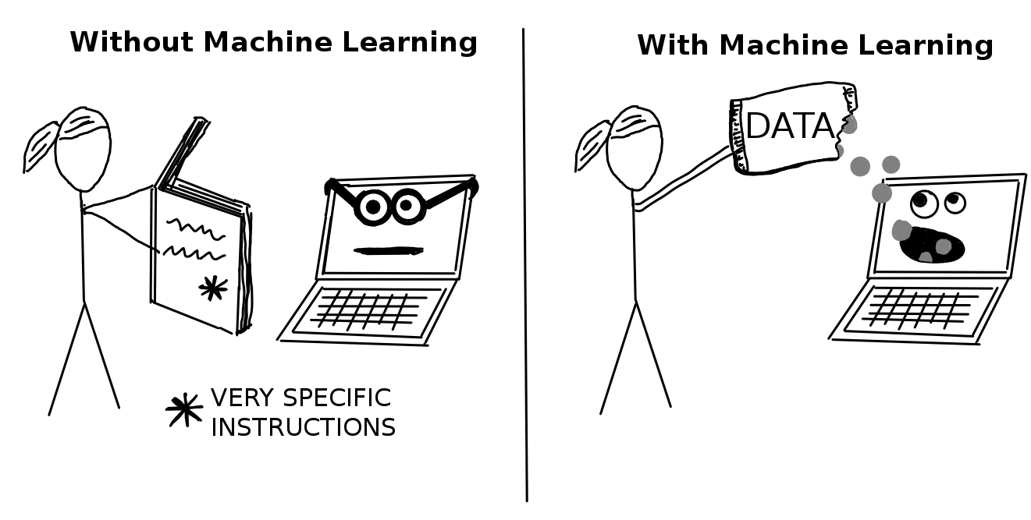
What is Machine Learning?
Learn to improve algorithms from data.
Why?
Human expertise does not exist (ex: complex medical processes we don’t fully understand)
Humans are unable to explain their expertise (speech recognition)
Solution change or adapt in time (routing on a computer network)
Traditional approach
Domain or expert knowledge
Machine Learning Data-driven

Slide 8
Example 1: Digit Recognition
Problem: Recognize a digit from the image
MNIST dataset challenge
Dataset developed in 1990s to spur AI research on a challenging problem for the time
Data taken from census forms
Became a classic benchmark for machine vision problems

Slide 9
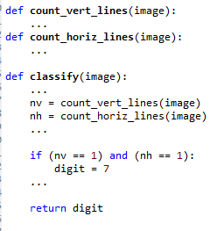
Classical “Expert” Approach
Idea: Use your knowledge about digits
You are an “expert” since you can do the task
Construct simple rules and code them
Expert rule example: “Image is a digit 7 if…”:
There is a single horizontal line, and
There is a single vertical line
Rule seems simple and reasonable
But,…

Slide 10

Problems with Expert Rules
Simple expert rule breaks down in practice
Hard to define a “line” precisely
Orientation, length, thickness, …
May be multiple lines…
General problem: We cannot easily code our knowledge
We can do the task
But, it is hard to translate to simple mathematical formula

Slide 11
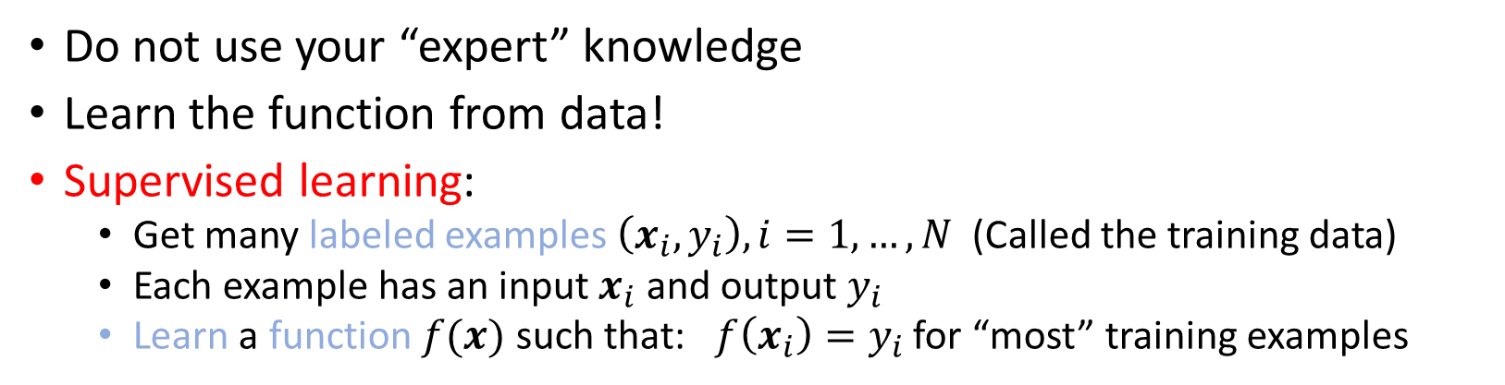
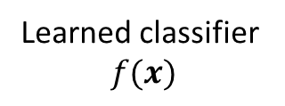
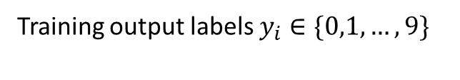

ML Approach: Learn from Data
Training inputs images $x_{i}$ (ex. 5000 ex per class)
?
Training output labels $y_{i}∈\{0,1,…,9\}$
Learned classifier $$f(x)$$
Do not use your “expert” knowledge
Learn the function from data!
Supervised learning:
Get many labeled examples $\left(x_{i},y_{i}\right), i=1,…,N$ (Called the training data)
Each example has an input $x_{i}$ and output $y_{i}$
Learn a function $f(x)$ such that: $f\left(x_{i}\right)=y_{i}$ for “most” training examples

Slide 12
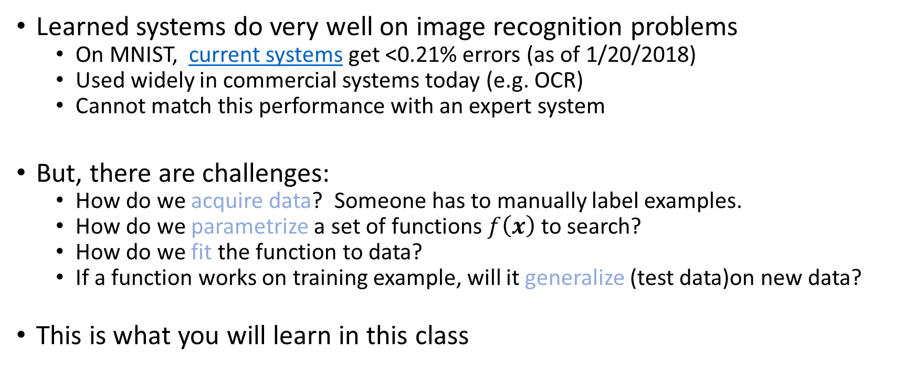
ML Approach Benefits and Challenges
Learned systems do very well on image recognition problems
On MNIST, current systems get <0.21% errors (as of 1/20/2018)
Used widely in commercial systems today (e.g. OCR)
Cannot match this performance with an expert system
But, there are challenges:
How do we acquire data? Someone has to manually label examples.
How do we parametrize a set of functions $f\left(x\right)$ to search?
How do we fit the function to data?
If a function works on training example, will it generalize (test data)on new data?
This is what you will learn in this class

Slide 13
Example 2: Face Detection
Problem: For each image region, determine if face or non-face
More challenging than digit recognition
Even harder to describe a face via “rules” in a robust way

Slide 14
Supervised Learning Approach
Data: Get large number of face and non-face examples
Typical early dataset
5000 faces (all near frontal, vary age, race, gender, lighting)
10^8 non faces
Faces are normalized (scale, translation)
Learn a classifier from a class of functions
Each function maps image to binary value “face” or “non-face”
Select function that works well on training data
For good performance, functions may be complex
Many parameters
Many more datasets are available now:
See http://www.face-rec.org/databases/
You can use this for your project!
Rowley, Baluja and Kanade, 1998

Slide 15
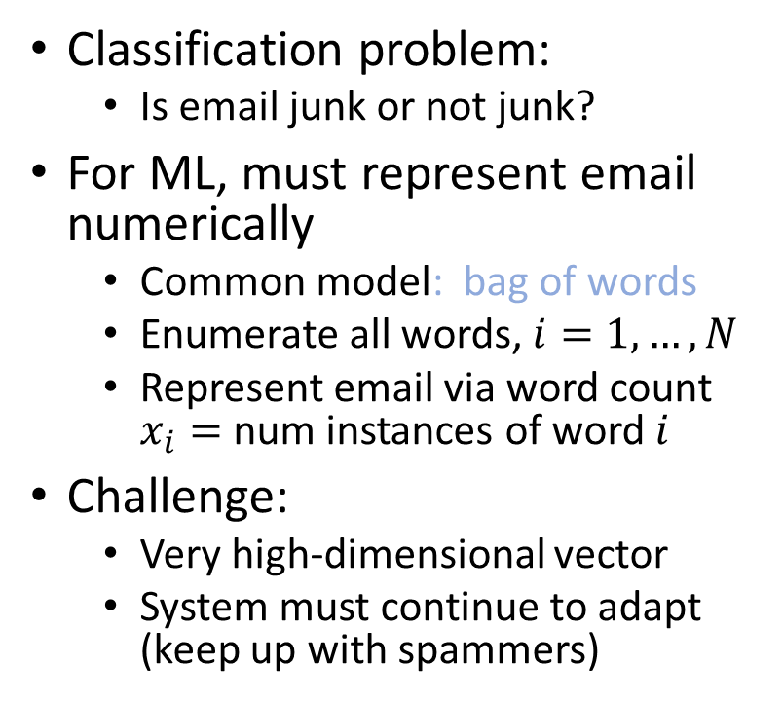
Example 3: Spam Detection
Classification problem:
Is email junk or not junk?
For ML, must represent email numerically
Common model: bag of words
Enumerate all words, $i=1,…,N$
Represent email via word count $x_{i}=$ num instances of word $i$
Challenge:
Very high-dimensional vector
System must continue to adapt (keep up with spammers)

Slide 16
Example 4: Stock Price Prediction
Can you predict the price of a stock?
What variables would you use?
What is a non-machine learning approach?

Slide 17

Problems that machine learning can solve
Any other examples that you may know?

Slide 18
Identifying the ZIP code from handwritten digits on an envelope.
Here the input is a scan of the handwriting, and the desired output is the actual digits in the zip code. To create a data set for building a machine learning model, you need to collect many envelopes. Then you can read the zip codes yourself and store the digits as your desired outcomes.
Determining whether or not a tumor is benign based on a medical image.
Here the input is the image, and the output is whether or not the tumor is benign. To create a data set for building a model, you need a database of medical images. You also need an expert opinion, so a doctor needs to look at all of the images and decide which tumors are benign and which are not.
Detecting fraudulent activity in credit card transactions. Here the input is a
record of the credit card transaction, and the output is whether it is likely to be fraudulent or not. Assuming that you are the entity distributing the credit cards, collecting a dataset means storing all transactions, and recording if a user reports any transaction as fraudulent.

Slide 19
However, using hand-coded rules to make decisions has two major
disadvantages:
The logic required to make a decision is specific to a single domain and task. Changing the task even slightly might require a rewrite of the whole system.
Designing rules requires a deep understanding of how a decision should be made by a human expert.
One example of where this hand-coded approach will fail is in detecting faces in images.
Today every smart phone can detect a face in an image. However, face detection was an unsolved problem until as recent as 2001. The main problem is that the way in which pixels (which make up an image in a computer) are “perceived by” the computer is very different from how humans perceive a face. This difference in representation makes it basically impossible for a human to come up with a good set of rules to describe what constitutes a face in a digital image.
Using machine learning, however, simply presenting a program with a large collection of images of faces is enough for an algorithm to determine what characteristics are needed to identify a face.

Slide 20
Machine Learning in Many Fields
Retail: Market basket analysis, Customer relationship management (CRM)
Finance: Credit scoring, fraud detection
Manufacturing: Control, robotics, troubleshooting
Medicine: Medical diagnosis
Telecommunications: Spam filters, intrusion detection
Bioinformatics: Motifs, alignment
Web mining: Search engines
...

Slide 22
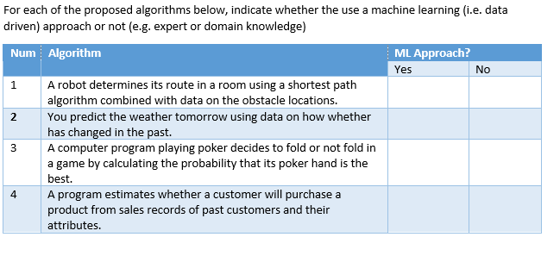
In-Class Exercise 1

Slide 23
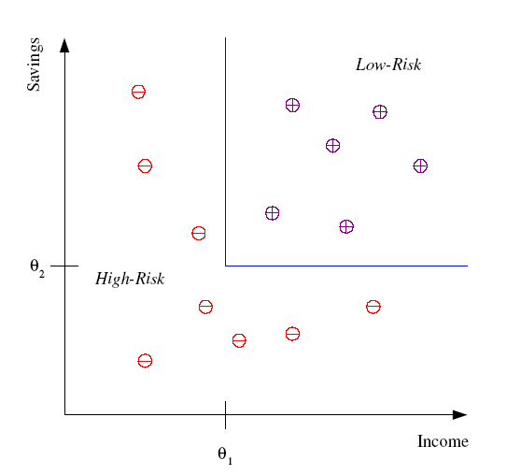
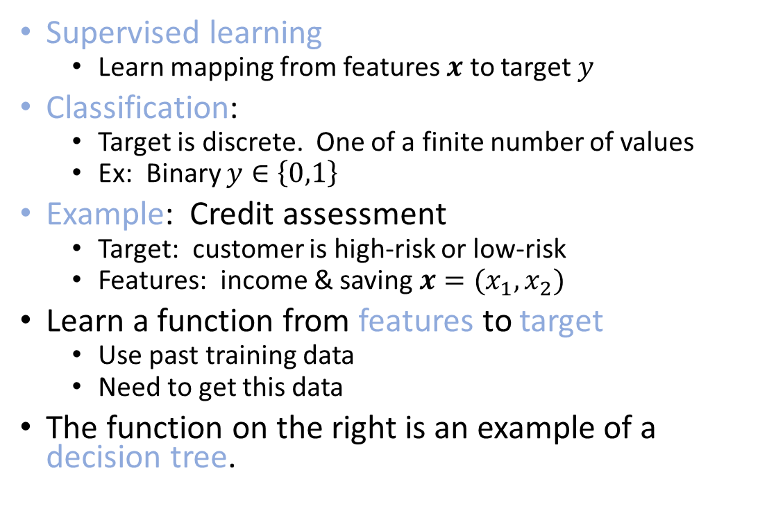


Classification
Supervised learning
Learn mapping from features $x$ to target $y$
Classification:
Target is discrete. One of a finite number of values
Ex: Binary $y∈\left\{0,1\right\}$
Example: Credit assessment
Target: customer is high-risk or low-risk
Features: income & saving $x=(x_{1},x_{2})$
Learn a function from features to target
Use past training data
Need to get this data
The function on the right is an example of a decision tree.
Savings
Low risk
$$x_{2}$$
High risk
$$x_{1}$$
Income

Slide 24

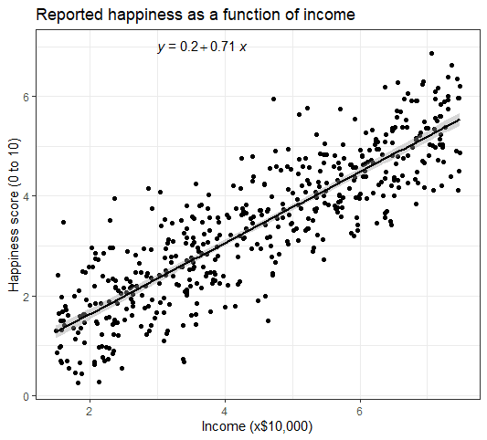
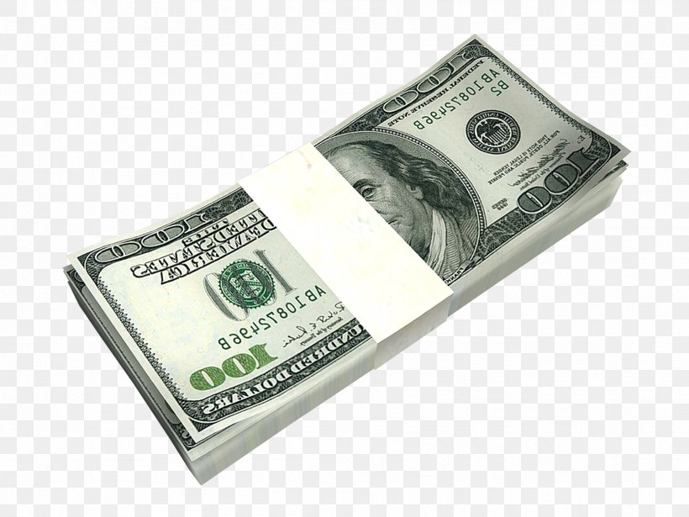
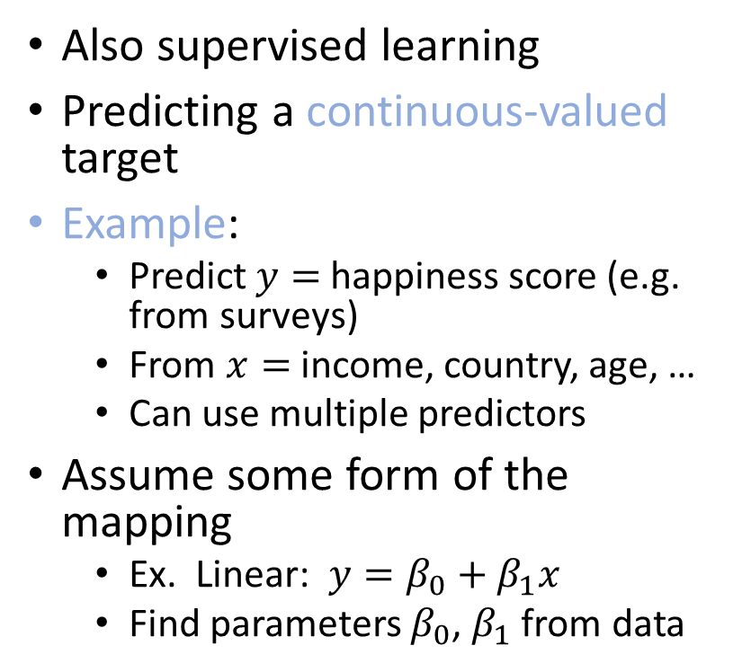
Regression
Also supervised learning
Predicting a continuous-valued target
Example:
Predict $y=$happiness score (e.g. from surveys)
From $x=$ income, country, age, …
Can use multiple predictors
Assume some form of the mapping
Ex. Linear: $y=β_{0}+β_{1}x$
Find parameters $β_{0}$, $β_{1}$ from data
Happiness Score
Income
https://www.scribbr.com/statistics/simple-linear-regression/

Slide 25
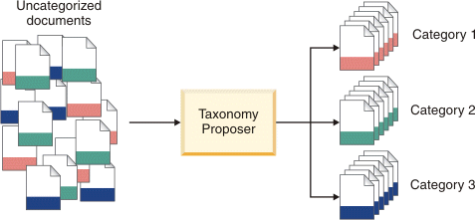
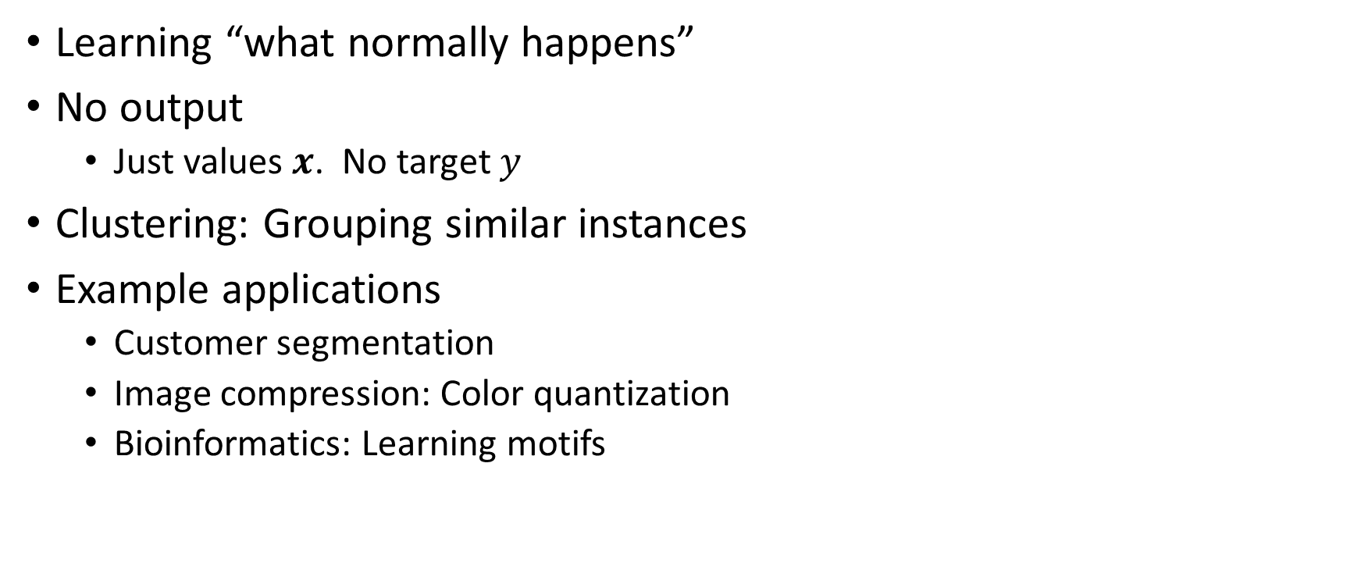
Unsupervised Learning
Learning “what normally happens”
No output
Just values $x$. No target $y$
Clustering: Grouping similar instances
Example applications
Customer segmentation
Image compression: Color quantization
Bioinformatics: Learning motifs
Example: Document classification
http://www.ibm.com/support/knowledgecenter /SSBRAM_8.7.0/com.ibm.classify.ccenter.doc/ c_WBG_Taxonomy_Proposer.htm

Slide 26
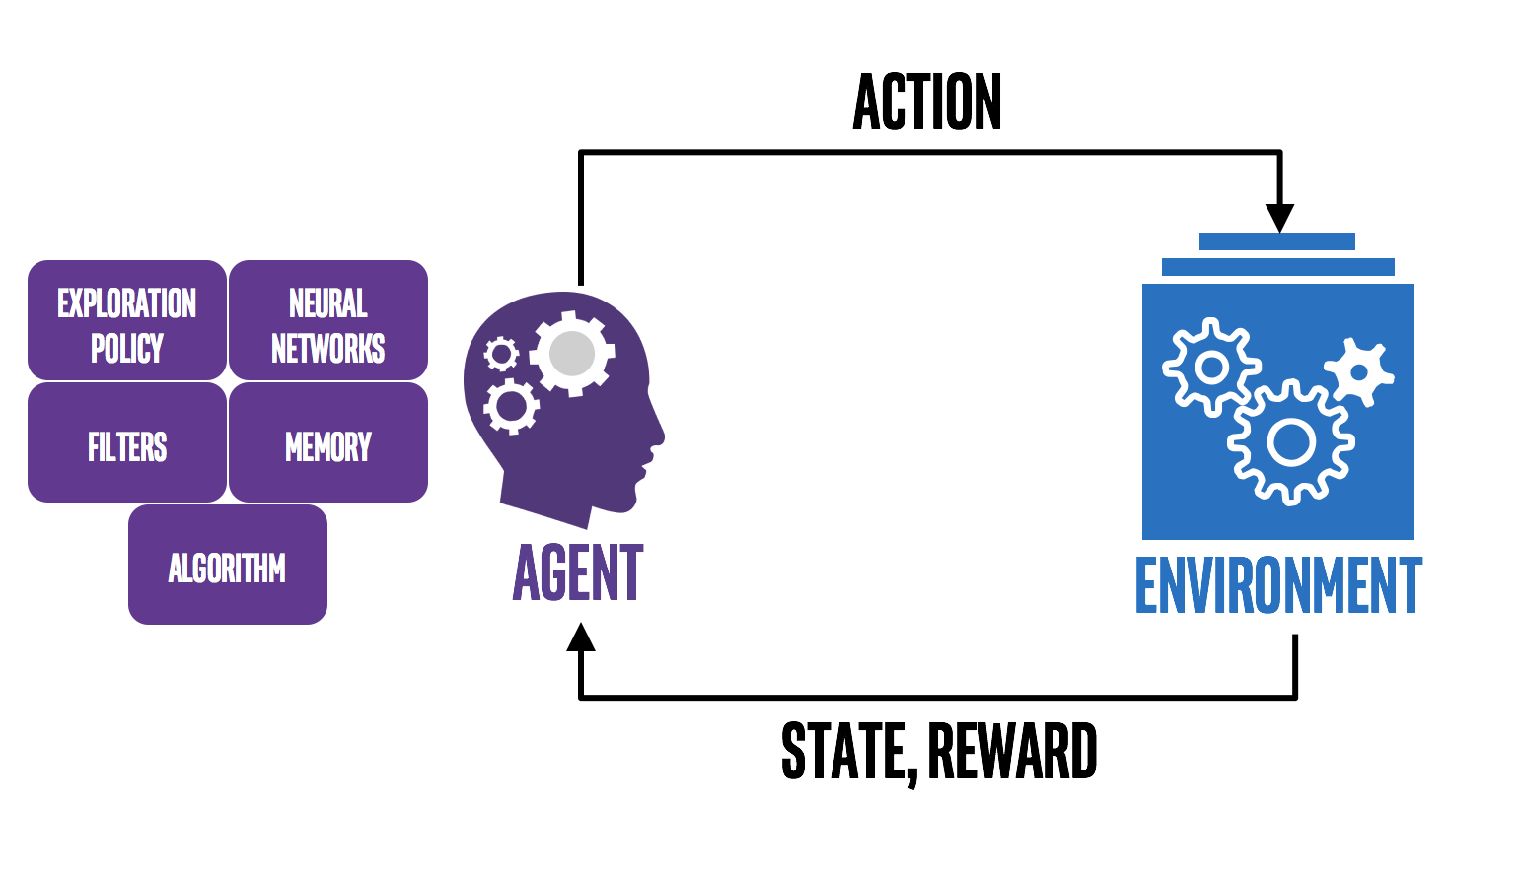
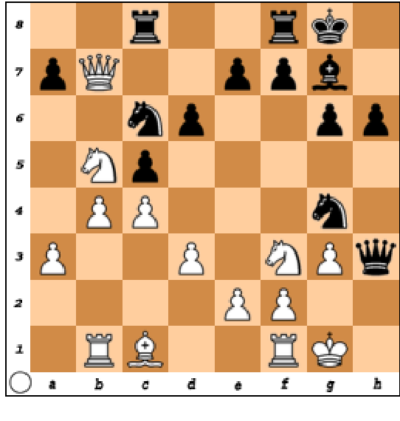
Reinforcement Learning
Move: …Bd4
State: Current position
Reward: Win or Lose
Agent learns to make actions that interact with an environment to maximize a reward
Agent typically acts in a closed loop system
Key tradeoffs:
Exploitation (Learn from past actions) vs. exploration (try new choices)
Credit assignment: Which actions in the past led to the current reward?

Slide 27
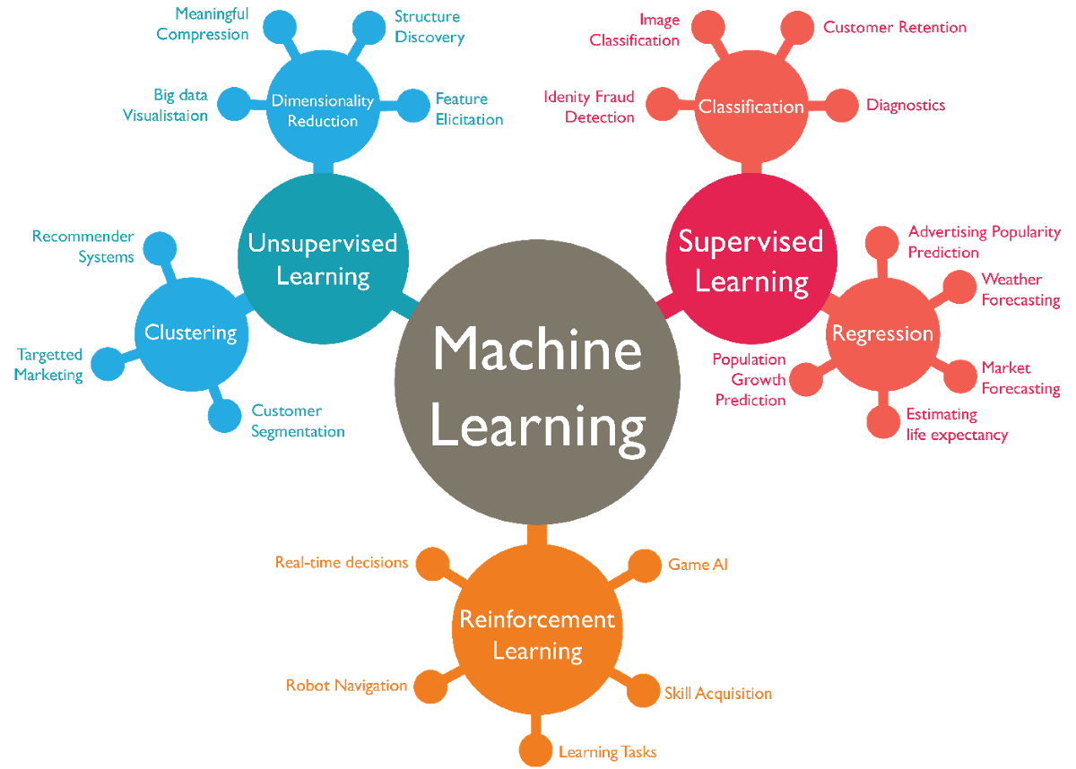
Types of Machine Learning

Slide 29
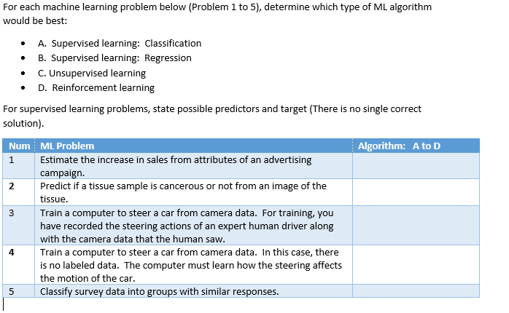
In-Class Exercise 2

Slide 30
Outline
What is Machine Learning?
Types of machine learning algorithms
Classification
Regression
Unsupervised learning
Why the hype today?
Some slides from:
A. Zisserman, “Machine Learning Introduction”
Alpaydin, “Introduction to Machine Learning”

Slide 31
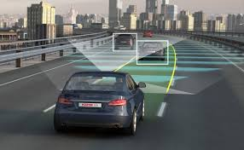
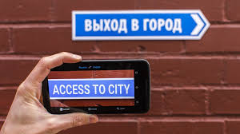
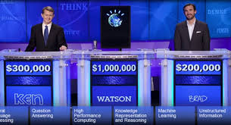
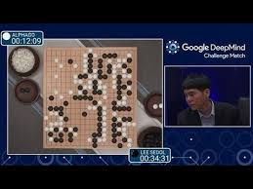
What ML is Doing Today?
Autonomous driving
Jeopardy
Very difficult games: Alpha Go
Machine translation
Many, many others…

Slide 32
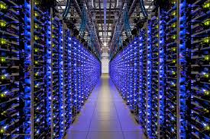
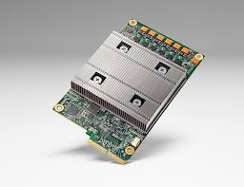
Why Now?
Machine learning is an old field
Much of the pioneering statistical work dates to the 1950s
So what is new now?
Big Data:
Massive storage. Large data centers
Massive connectivity
Sources of data from Internet and elsewhere
Computational advances
Distributed machines, clusters
GPUs and hardware
Google Tensor Processing Unit (TPU)

Slide 34
Exercise
Break into small groups
Take a field that interests you:
Ex. Driving a car, social networks, recommend a movie to watch, …
Identify a specific task that can be done with machine learning
What is the objective of the task?
What is the data you need?
What type of ML problem is this? Classification, regression, …
How would your approach compare to an expert-driven method?

